Slide 1

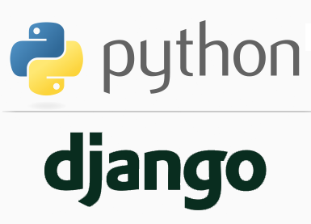
FULL STACK WEB DEVELOPMENT WITH DJANGO
Lecture 28

Slide 2

Today’s Agenda
Developing Our Django App
Getting Form Data
Validating Data
Getting Cleaned Data
CSRF Protection

Slide 3
Getting Form Data
To access Form data we must understand few terminologies:
Bounded and Unbounded Form
Validating Data
Cleaned Data
CSRF

Slide 4
Bounded And Unbounded Form
An unbound form has no data associated with it. When rendered to the user, it will be empty or will contain default values.
A bound form has submitted data, and hence can be used to tell if that data is valid. If an invalid bound form is rendered, it can include inline error messages telling the user what data to correct.
The form’s is_bound attribute will tell us whether a form has data bound to it or not.

Slide 5
Validating Data
When the users have completely filled form, they submit it.
The data received by the server needs to be validated.
Here, validation means all kinds of things. Like,
If it is a valid email or not.
The passwords matches with re-entered passwords or not.

Slide 6
Validating Data
When we validate our form data, we are actually converting them to python datatypes.
Then we can store them in the database.
This validation is necessary since it adds that layer of security where unethical data cannot harm our database.

Slide 7
How To Validate Form Data ?
There are different ways of form validation we can use , like:
Validating entire form at once
Validating a particular field
Validation using validators

Slide 8
Validating Entire Form
Django provides built-in methods to validate form data automatically and a popular method for this is is_valid()
The is_valid() method is used to perform validation for each field of the form, it is defined in Django Form class.
It returns True if data is valid and place all data into a cleaned_data attribute.

Slide 9
Using Cleaned Data
Any data the user submits through a form will be passed to the server as strings.
It doesn't matter which type of form field was used to create the form.
Eventually, the browser would send everything as strings.

Slide 10
Using Cleaned Data
When Django cleans the data it automatically converts data to the appropriate type.
For example, IntegerField data would be converted to an integer, CharField data would be converted to a string, BooleanField data would be converted to a bool (True or False) and so on.
Once the data is cleaned and validated, Django makes it available via cleaned_data dictionary.

Slide 11
What Is CSRF ?
Cross-site request forgery (also known as CSRF) is a web security vulnerability that allows an attacker to induce users to perform actions that they do not intend to perform.
In other words , it is an attack vector that tricks a user into executing an unwanted action in an application to which a user is logged in.

Slide 12
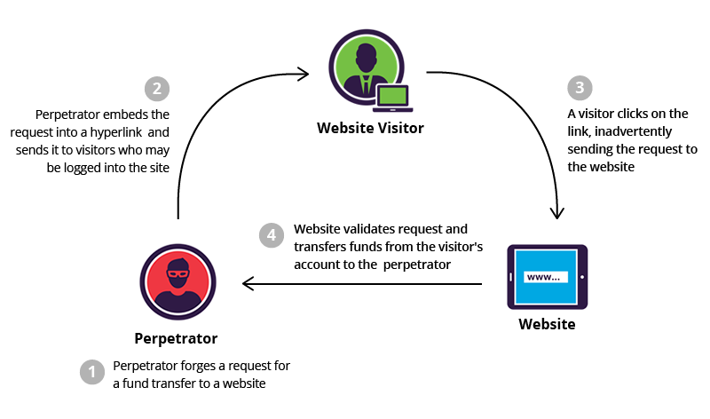
What Is CSRF ?

Slide 13
CSRF Working
Before executing an assault, a perpetrator typically studies an application in order to make a forged request appear as legitimate as possible.
For example, a typical GET request for a Rs 10000 bank transfer might look like:
GET http://netbank.com/transfer.do?acct=PersonB&amount=10000 HTTP/1.1

Slide 14
CSRF Working
A hacker can modify this script so it results in a Rs 10000 transfer to their own account.
Now the malicious request might look like:
GET http://netbank.com/transfer.do?acct=AttackerA&amount=10000 HTTP/1.1

Slide 15
CSRF Working
Next, he can distribute the hyperlink via email to a large number of bank customers.
Those who click on the link while logged into their bank account will unintentionally initiate the Rs 1000 transfer.

Slide 16
CSRF Working
Note that if the bank’s website is only using POST requests, it’s impossible to frame malicious requests using a <a> href tag.
However, the attack could be delivered in a <form> tag with automatic execution of the embedded JavaScript.

Slide 17
CSRF Working
This is how such a form may look like:
<body onload="document.forms[0].submit()">
<form action=http://netbank.com/transfer.do method="POST"> <input type="hidden" name="acct" value="AttackerA"/>
<input type="hidden" name="amount" value=“Rs 10000"/>
<input type="submit" value="View my pictures!"/>
</form>
</body>

Slide 18
Django’s CSRF Token
Django provides built in mechanism to prevent our Form from CSRF attacks.
Django forces us to use a tag called csrf_token in any template that uses a POST form, inside the <form> element.
Example:
<form method="post">{% csrf_token %}

Slide 19
Django’s CSRF Token
If the form does not have csrf_token then Django simply throws a HTTP error as 403 when we submit the form, as sown below:
Forbidden (403) CSRF verification failed. Request aborted.

